Slide 1
Statistics for Graduate Students: Class #1
The replication crisis
Principles of Null Hypothesis Significance Testing (NHST)
One-sample Z and t tests

Slide 2


Welcome!
Noam Siegelman
Departments of Psychology, Brain and Cognitive Sciences
noam.siegelman@mail.huji.ac.il
Gal Chen
Department of Psychology
galrefa.chen@mail.huji.ac.il
Course Moodle:
https://moodle2.cs.huji.ac.il/nu22/course/view.php?id=51735

Slide 3

The Replication Crisis in Psychology
1950’s-1990’s: Once a (long) while, a paper reporting a replication attempt (and sometime, failure).
Both exact and conceptual replications.
Starting from the early 2000’s, some doubts are raised regarding the reproducibility of famous effects in Psychology.
Some “whispers” about failures to replicate.
Ioannidis, 2005, a simulation study: “Why Most Published Research Studies are False”
Not specific to Psychology,
Based on multiple assumptions,
The bottom line: >50% of positive findings are not replicable, reflecting false positives.
In 2011, reproducibility in psychology becomes a hot topic…
>1000
100-200

Slide 4

The Replication Crisis in Psychology
Diederik Stapel is accused of falsifying data from (at least) 58 published papers.
Including PhD work by 19 students.
The final paper (Science, 2011)
The data are simply to good go be true…

Slide 5
The Replication Crisis in Psychology
Obviously, only (very?) few researchers falsify data.
Still, lots of attention turned to the question: To what extent studies in Psychology are reproducible?
In 2012, a large-scale reproducibility project gets underway…
By the “Open Science Collaboration” (also: “Open Science Foundation”, OSF)
Findings are published in 2015 (Science)

Slide 6
Estimating the Reproducibility of Psychological Science (Open Science Collaboration, 2015, Science)
100 studies (“randomly” sampled) from Social and Cognitive Psychology, 97 studies of them reported significant findings originally.
270 scientists participate in replication attempts, often in cooperation with authors of original papers.
Two big questions:
1) How many studies will be replicated?
The first ever systematic, large-scale, empirical estimate of reproducibility
2) What factors predict reproducibility?

Slide 7
Estimating the Reproducibility of Psychological Science (Open Science Collaboration, 2015, Science)
The headline: Overall, 35/97 replications (36%!) found a significant effect (in the same direction).
Versus an average statistical power (=probability of finding an effect assuming one exists) of 0.92 in replication attempts.
Based on some assumptions: to be discussed…
Crucially: a substantial increase in p-values; a substantial decrease in effect size estimates.

Slide 8
Estimating the Reproducibility of Psychological Science (Open Science Collaboration, 2015, Science)
What predicts higher reproducibility?
Sub-field within Psychology
Original p-value and effect size estimate (but, limited correlations, r=~0.3)
Expert ratings of how surprising the original effect was.

Slide 9



Estimating the Reproducibility of Psychological Science (Open Science Collaboration, 2015, Science)
Huge scientific impact (e.g., Google Scholar >7000 citations).
Findings send waves beyond the scientific community…

Slide 10


Estimating the Reproducibility of Psychological Science (Open Science Collaboration, 2015, Science)
Not just in Psychology…

Slide 11
The burning questions…
How did we get here? Why such a small proportion of studies in our field are reproducible?
“Statistical” reasons: limited methods for statistical inference, violation of assumptions, “false-positive Psychology”, limited statistical power…
“Societal” reasons: “Publish or perish” culture, push for innovation (at the expense of rigor?), structure of scientific publishing and file-drawer problem…
What can we learn from the crisis? What should we do going forward?
Appropriate use of Null Hypothesis Significance Testing (NHST) (i.e., ‘classic’ tools).
Additional tools to supplement NHST.
Both statistical, methodological, and societal.
Notes:
What do you think??

Slide 12
Statistics for Graduate Students: Course Topics
1. Refresher(+): Basic statistical methods (and how [not] to use them).
What is NHST? What are its conceptual foundations?
Classic NHST tests: Z and t-tests, ANOVA, correlation & regression.
2. Advanced statistical tools
Multiple regression – (semi-)advanced topics.
Mixed-effect models.
Introduction to other (multivariate, non-frequentist, non-parametric) approaches (much more next semester).
3. How to conduct a study and run an analysis with maximal reproducibility?
Minimization of statistical errors (avoiding inflation of Type I and Type II errors).
Beyond dichotomous inference (confidence intervals, effect size estimates).
Pre-registration, Registered Reports (among other methodological/societal tools).
Notes:
Foundations that shape how we should use it and what we can infer form it?

Slide 13


Statistics for Graduate Students: Course Topics
Introduction to R (and Rstudio)
R as a tool for statistical computing, applying statistical tests (basic + advanced).
Using R for simulations (auxiliary tools for understanding stats principles).
Basic data visualization techniques.
Important for reproducibility, too!

Slide 14
Statistics for Graduate Students: General features
Intuitions & principles > math
BUT: some math… (often, via auxiliary materials).
Hands-on practice > theory
BUT: highlighting overarching theoretical foundations.
Minor assumptions about prior knowledge
BUT: N of assumptions > 0
A new perspective on old material: focus on current (and fierce) discussions.

Slide 15
Statistics for Graduate Students: From t Tests to Mixed-Effect Models
Class # | Class: Topics | Tutorial # | Tutorial: Topics
1 | Replication crisis in psychology Hypothesis testing: An intro; One-sample Z and t-tests | 1 | Intro to R I
 | (No class – elections) | 1b | Intro to R II: Basic tests, simulations
2 | Statistical errors I: Refresher Two-sample t-test (independent + paired) Beyond dichotomous inference | 2 | Assumption violation and statistical errors – simulations.
3 | Statistical errors II: How many findings are false?; power analysis One-way and two-way ANOVA | 3 | Power analysis in R One-way ANOVA in R
4 | Contrasts (Planned vs. posthoc) Statistical errors III: False-positive psychology | 4 | Contrasts False-positive psychology simulations
5 | ANOVAs: within-subject and beyond. Correlation, regression | 5 | Repeated measures ANOVA Simple linear models in R
6 | Multiple regression I: Control variables, (Multi)collinearity, Mediation, categorical predictors | 6 | Multiple regression in R I
7 | Multiple regression II: Interactions, centering & Transformation of variables, logistic models | 7 | Multiple regression in R II
 | Vacation |  | Vacation
8 | Mixed-effect models I: Fixed vs. random effects, significance testing | 8 | Mixed-effect models in R I
9 | Mixed-effect models II: Coding, interactions, centering & Transformations, Logistic LMM | 9 | Mixed-effect models in R II
10 | Mixed-effect models III: Determining random effect structure | 10 | Mixed-effect models in R III
11 | Summary so far Introduction to multivariate, non-parametric, and Bayesian inference | 11 | Multiple DVs (multivariate)
12 | Student presentations | 12 | Multiple DVs (multivariate)
13 | Student presentations *two weeks into break
More familiar (but: more advanced discussions,
Must-read papers,
R inc. simulations)
Frequentist, parametric, univariate methods
More novel

Slide 16
Statistics for Graduate Students: Technical notes
Grade composition:
1. Five homework assignments (30%)
2. Final assignment:
2.1 In-class presentation (10%).
2.2 Final write-up (60%).
Ask questions in Q&A forum.
Recordings of classes and tutorials are uploaded automatically after each class, but attendance is highly important!
Details soon!

Slide 17
Null Hypothesis Significance Testing (NHST): Foundations and principles

Slide 18
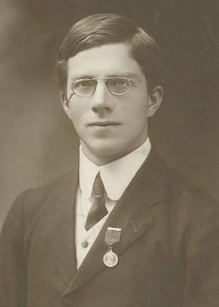

Null Hypothesis Significant Testing (NHST): The conceptual basis
Founder: Sir Ronald Fischer (1890-1962, UK)
Question (1935): Can the lady tasting tea (Muriel Bristol) identify what was added first to a teacup: Tea or milk?
The method: An experiment + hypothesis testing
8 teacups (i.e., trials), the lady tastes a teacup and is asked to determine way of preparation (tea vs. milk first).

Slide 19
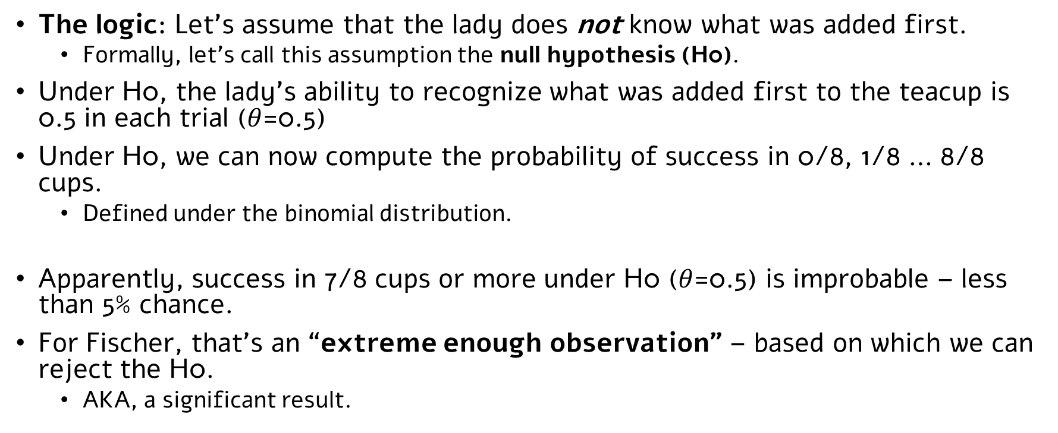
Null Hypothesis Significant Testing (NHST): The conceptual basis
The logic: Let’s assume that the lady does not know what was added first.
Formally, let’s call this assumption the null hypothesis (H0).
Under H0, the lady’s ability to recognize what was added first to the teacup is 0.5 in each trial ($θ$=0.5)
Under H0, we can now compute the probability of success in 0/8, 1/8 … 8/8 cups.
Defined under the binomial distribution.
Apparently, success in 7/8 cups or more under H0 ($θ$=0.5) is improbable – less than 5% chance.
For Fischer, that’s an “extreme enough observation” – based on which we can reject the H0.
AKA, a significant result.

Slide 20
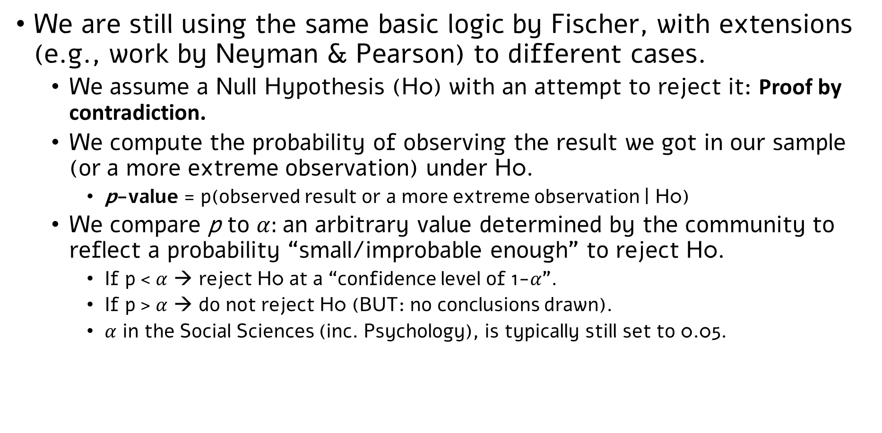
Almost 90 years later…
We are still using the same basic logic by Fischer, with extensions (e.g., work by Neyman & Pearson) to different cases.
We assume a Null Hypothesis (H0) with an attempt to reject it: Proof by contradiction.
We compute the probability of observing the result we got in our sample (or a more extreme observation) under H0.
p-value = p(observed result or a more extreme observation | H0)
We compare p to $α:$an arbitrary value determined by the community to reflect a probability “small/improbable enough” to reject H0.
If p < $α$ → reject H0 at a “confidence level of 1-$α$”.
If p > $α$ → do not reject H0 (BUT: no conclusions drawn).
$α$ in the Social Sciences (inc. Psychology), is typically still set to 0.05.

Slide 21
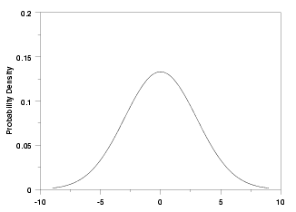
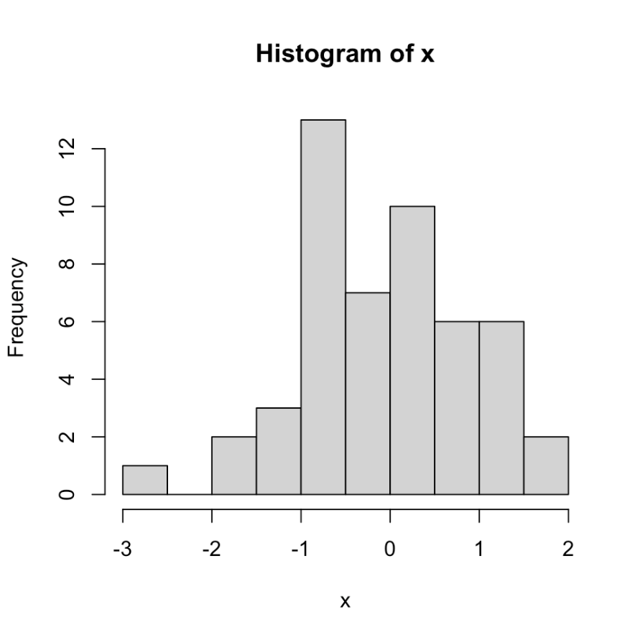
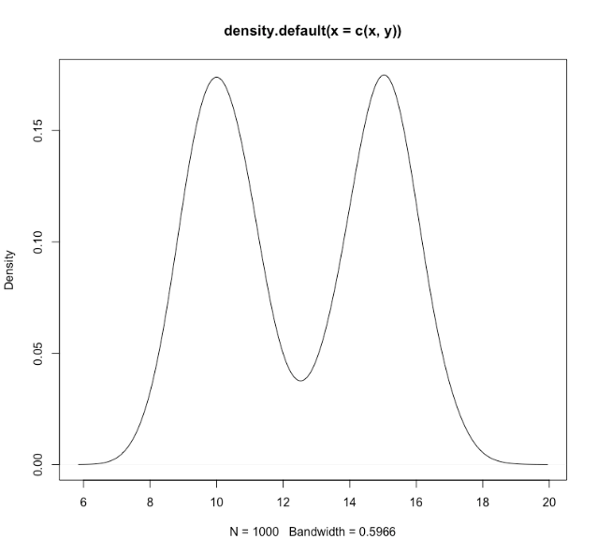
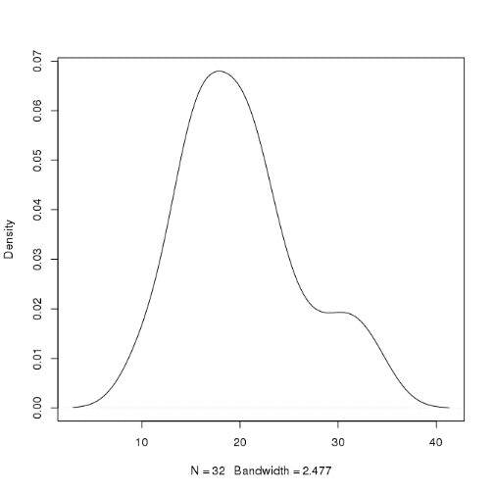
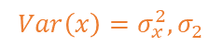
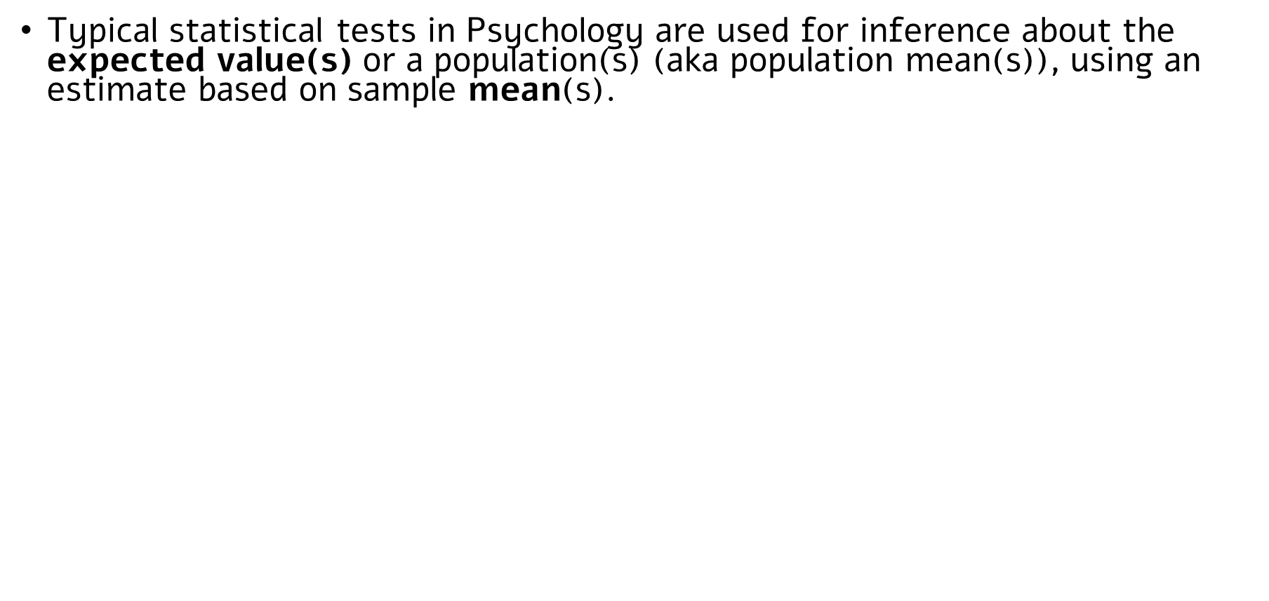
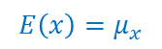
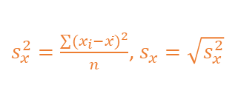
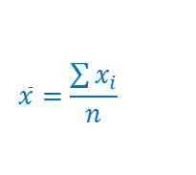
Statistical tests: Inference about expected values
Typical statistical tests in Psychology are used for inference about the expected value(s) or a population(s) (aka population mean(s)), using an estimate based on sample mean(s).
To compute p-values, these tests make use of assumptions about the sampling distribution of the mean (or another estimate derived from means, e.g., difference between means).
Refresher: A sampling distribution = for a given statistic, a theoretical distribution after an infinite number of samples, with a given sample size (N).
https://onlinestatbook.com/stat_sim/sampling_dist/
That is: We build a sampling distribution for our statistic under H0, and compute the probability of the estimate we observed in our sample (or a more extreme observation) under this distribution.
→ If p < $α$, reject H0
Population
Sample
$s_{x}^{2}=\frac{\sum{{(x_{i}−\overline{x})}^{2}}}{n}$, $s_{x}=\sqrt{s_{x}^{2}}$
$${Var\left(x\right)=σ}_{x}^{2},σ_{2}$$
$$\overline{x}=\frac{\sum{x_{i}}}{n}$$
$$E\left(x\right)=μ_{x}$$

Slide 22
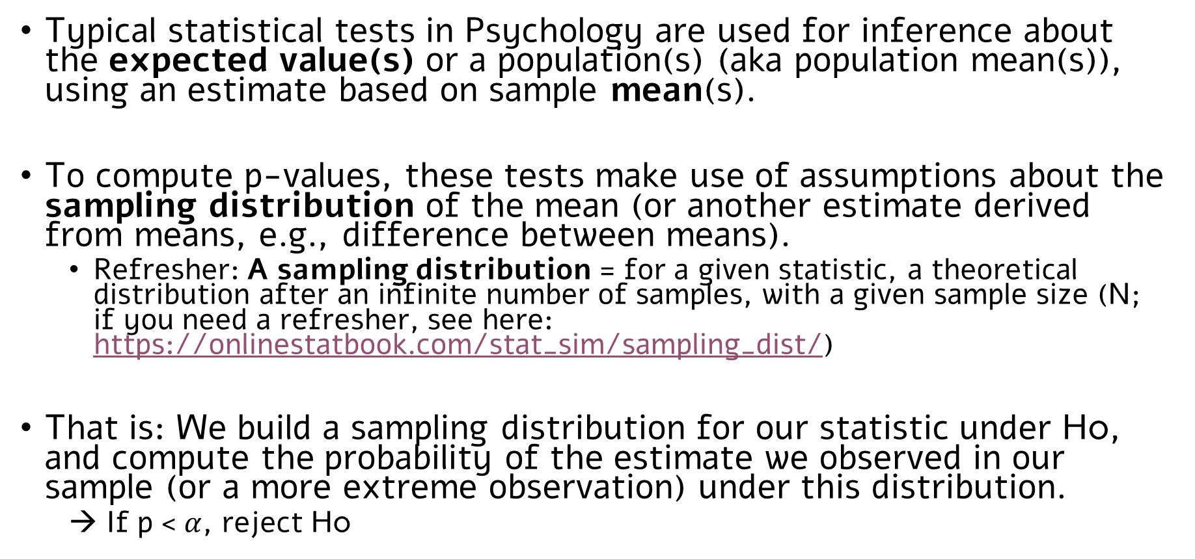
Statistical tests: Inference about expected values
Typical statistical tests in Psychology are used for inference about the expected value(s) or a population(s) (aka population mean(s)), using an estimate based on sample mean(s).
To compute p-values, these tests make use of assumptions about the sampling distribution of the mean (or another estimate derived from means, e.g., difference between means).
Refresher: A sampling distribution = for a given statistic, a theoretical distribution after an infinite number of samples, with a given sample size (N; if you need a refresher, see here: https://onlinestatbook.com/stat_sim/sampling_dist/)
That is: We build a sampling distribution for our statistic under H0, and compute the probability of the estimate we observed in our sample (or a more extreme observation) under this distribution.
→ If p < $α$, reject H0

Slide 23
A very basic statistical test: One-sample z-test

Slide 24
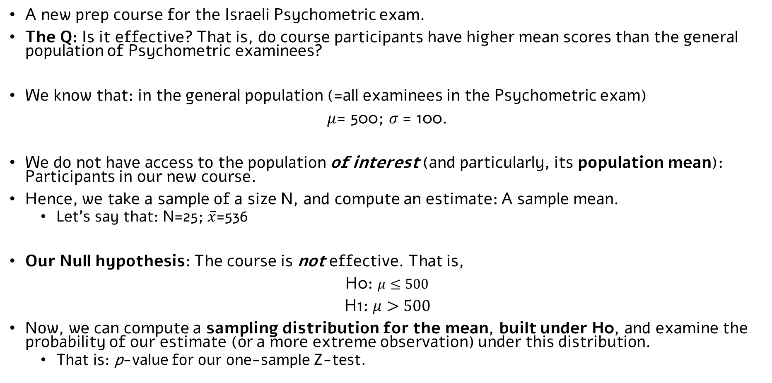
An example
A new prep course for the Israeli Psychometric exam.
The Q: Is it effective? That is, do course participants have higher mean scores than the general population of Psychometric examinees?
We know that: in the general population (=all examinees in the Psychometric exam)
$μ$= 500; $σ$= 100.
We do not have access to the population of interest (and particularly, its population mean): Participants in our new course.
Hence, we take a sample of a size N, and compute an estimate: A sample mean.
Let’s say that: N=25; $\overline{x}$=536
Our Null hypothesis: The course is not effective. That is,
H0: $μ≤500$
H1: $μ>500$
Now, we can compute a sampling distribution for the mean, built under H0, and examine the probability of our estimate (or a more extreme observation) under this distribution.
That is: p-value for our one-sample Z-test.

Slide 25
Sampling Distribution of the Mean
To do that, we need to answer three questions:
What is the expected value of the mean’s sampling distribution?
What is the variance of the mean’s sampling distribution?
What is the shape of the mean’s sampling distribution?

Slide 26
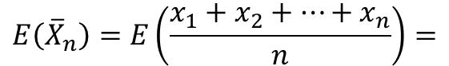

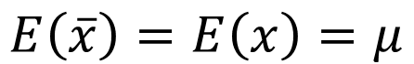



Sampling Distribution of the Mean
To do that, we need to answer three questions:
What is the expected value of the mean’s sampling distribution?
What is the variance of the mean’s sampling distribution?
What is the shape of the mean’s sampling distribution?
$$E\left(\overline{x}\right)=E\left(x\right)=μ$$
$$\frac{1}{n}E\left(x_{1}+x_{2}+…+x_{n}\right)$$
$$E\left({\overline{X}}_{n}\right)=E\left(\frac{x_{1}+x_{2}+…+x_{n}}{n}\right)=$$
Definition of Expected Value (constant)
$$=\frac{1}{n}\left[E\left(x_{1}\right)+E\left(x_{2}\right)+…+E\left(x_{n}\right)\right]$$
X1…Xn are independent
$$=\frac{1}{n}\left[μ+μ+…+μ\right]$$
Expected values of X1…Xn are equal
(random sampling)
$$=\frac{1}{n}μ∗n=μ$$

Slide 27
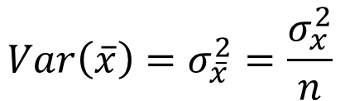

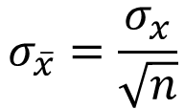
Sampling Distribution of the Mean
To do that, we need to answer three questions:
What is the expected value of the mean’s sampling distribution?
What is the variance of the mean’s sampling distribution?
What is the shape of the mean’s sampling distribution?
$$Var\left(\overline{x}\right)=σ_{\overline{x}}^{2}=\frac{σ_{x}^{2}}{n}$$
Also known as Standard Error (SE)
$$σ_{\overline{x}}=\frac{σ_{x}}{\sqrt{n}}$$
$$Var\left(\overline{x}\right)=Var\left(\frac{x_{1}+x_{2}+…+x_{n}}{n}\right)$$
$$=\frac{1}{n^{2}}Var\left(x_{1}+x_{2}+…+x_{n}\right)$$
Definition of variance (constant)
$$=\frac{1}{n^{2}}V\left(x_{1})+V(x_{2})+…+V(x_{n}\right)$$
X1…Xn are independent
$$=\frac{1}{n^{2}}\left[σ^{2}+σ^{2}+…+σ^{2}\right]$$
Variance of X1…Xn is equal (random sampling)
$$=\frac{nσ^{2}}{n^{2}}=\frac{σ^{2}}{n}$$

Slide 28
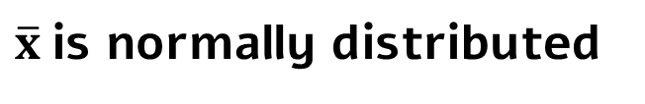
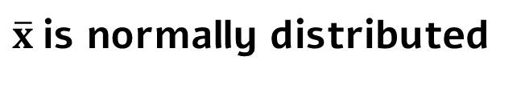
Sampling Distribution of the Mean
To do that, we need to answer three questions:
What is the expected value of the mean’s sampling distribution?
What is the variance of the mean’s sampling distribution?
What is the shape of the mean’s sampling distribution?
$\overline{x}$is normally distributed
If x is normally distributed
OR
If n is ‘large enough’ (typically, n≥30;
central limit theorem)
$\overline{x}$is normally distributed

Slide 29
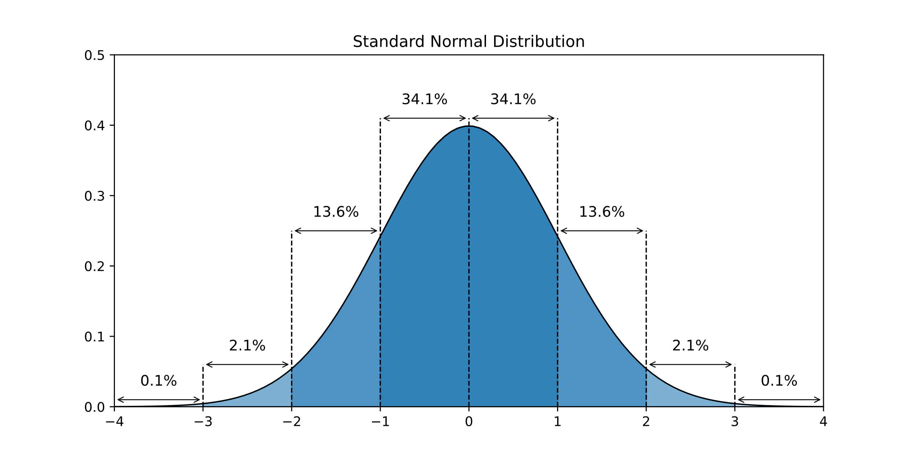
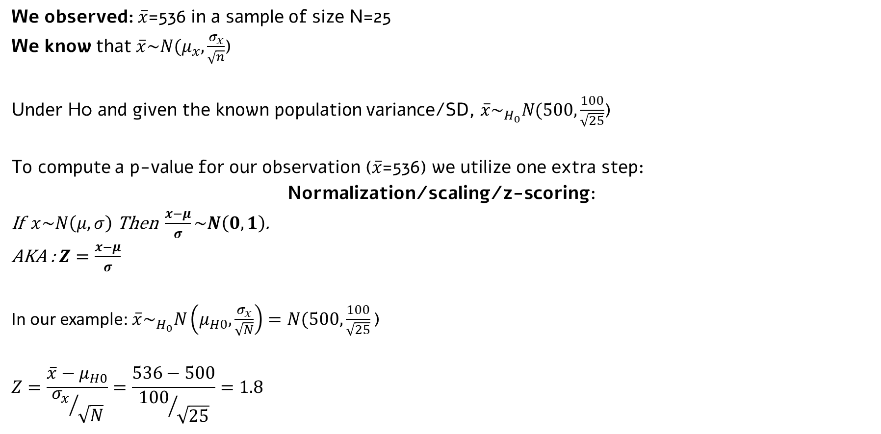
Back to our example
We observed: $\overline{x}$=536 in a sample of size N=25
We know that $\overline{x}\sim N(μ_{x},\frac{σ_{x}}{\sqrt{n}}$)
Under H0 and given the known population variance/SD, $\overline{x}\sim _{H_{0}}N(500,\frac{100}{\sqrt{25}}$)
To compute a p-value for our observation ($\overline{x}$=536) we utilize one extra step:
Normalization/scaling/z-scoring:
If $x\sim N\left(μ,σ\right)$ Then $\frac{x−μ}{σ}\sim N\left(0,1\right)$.
AKA : $Z=\frac{x−μ}{σ}$
In our example: $\overline{x}\sim _{H_{0}}N\left(μ_{H0}, \frac{σ_{x}}{\sqrt{N}}\right)=N(500, \frac{100}{\sqrt{25}}\text{)}$
$$Z=\frac{\overline{x}−μ_{H0}}{{σ_{x}}/{\sqrt{N}}}=\frac{536−500}{{100}/{\sqrt{25}}}=1.8$$
Why?

Slide 30
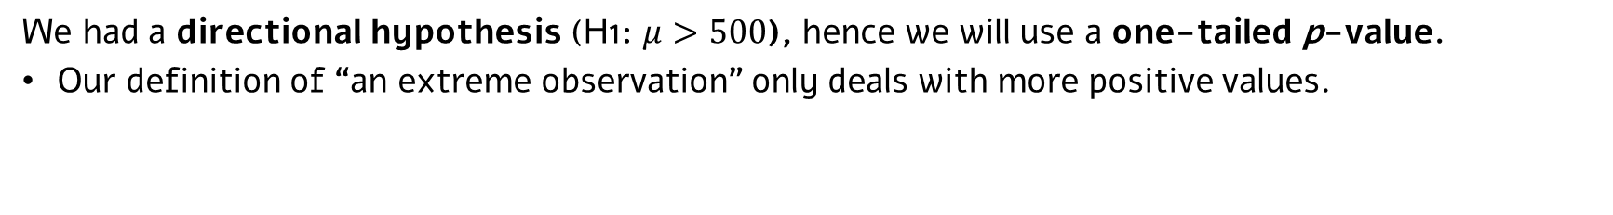
Is this extreme enough?
Compute p-value: based on the standard normal distribution:
One-tailed p-value:
p=0.0359
Z=1.8
We had a directional hypothesis (H1: $μ>500$), hence we will use a one-tailed p-value.
Our definition of “an extreme observation” only deals with more positive values.

Slide 31
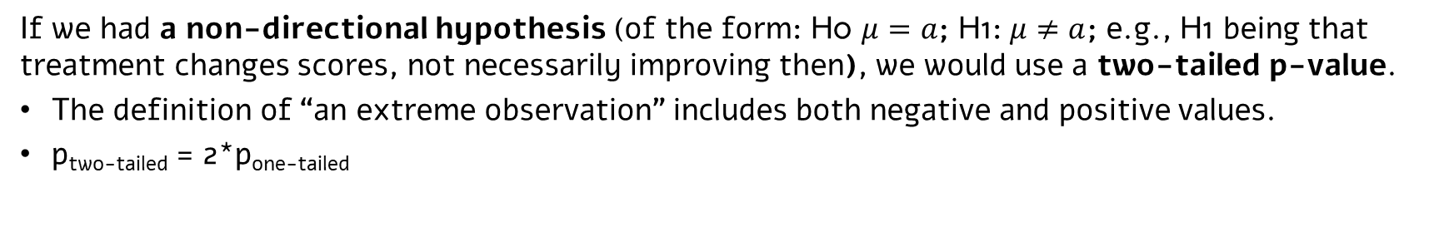
Is this extreme enough?
Compute p-value: based on the standard normal distribution:
Two-tailed p-value:
p=0.0718
Z=-1.8
Z=1.8
If we had a non-directional hypothesis (of the form: H0 $μ=a$; H1: $μ≠a$; e.g., H1 being that treatment changes scores, not necessarily improving then), we would use a two-tailed p-value.
The definition of “an extreme observation” includes both negative and positive values.
p_{two-tailed} = 2*p_{one-tailed}

Slide 32
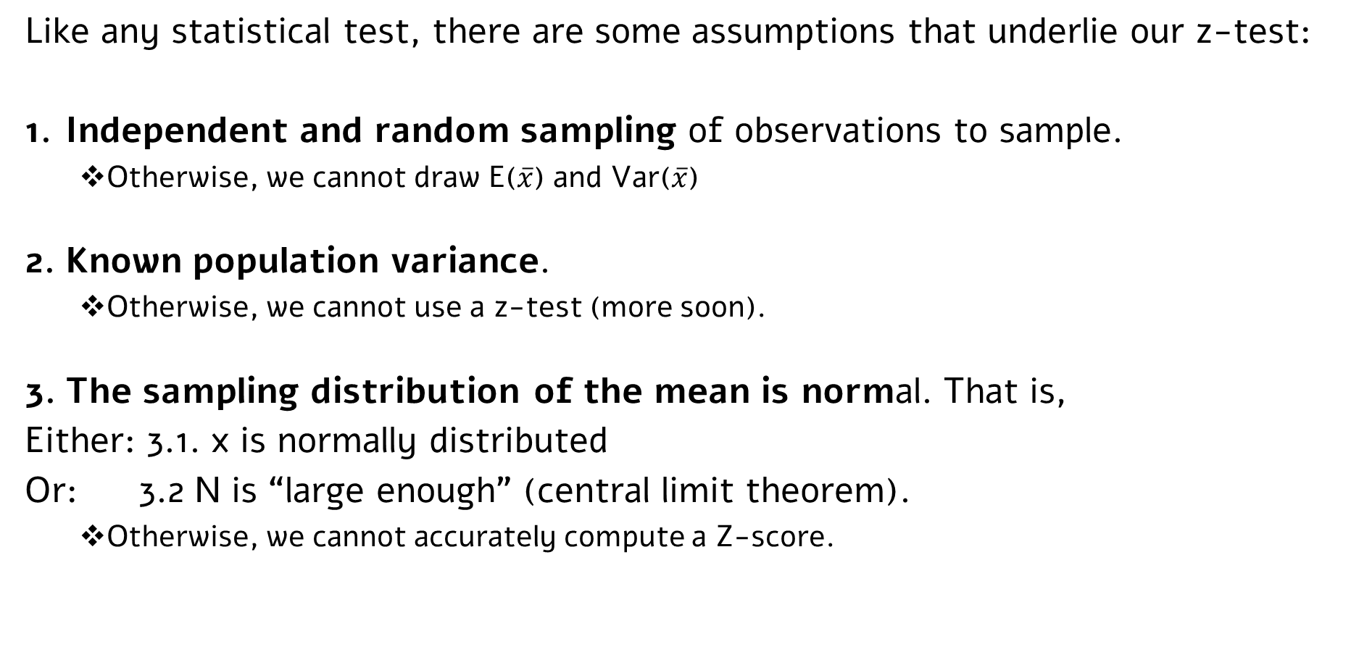
One sample Z-test: assumptions
Like any statistical test, there are some assumptions that underlie our z-test:
Independent and random sampling of observations to sample.
Otherwise, we cannot draw E($\overline{x}$) and Var($\overline{x}$)
Known population variance.
Otherwise, we cannot use a z-test (more soon).
The sampling distribution of the mean is normal. That is,
Either: 3.1. x is normally distributed
Or: 3.2 N is “large enough” (central limit theorem).
Otherwise, we cannot accurately compute a Z-score.

Slide 33
A slightly less basic statistical test: One-sample t-test

Slide 34
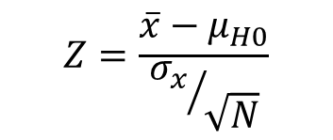
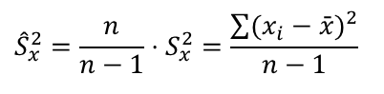
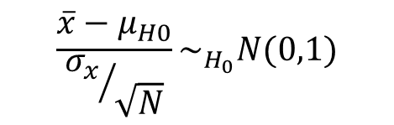
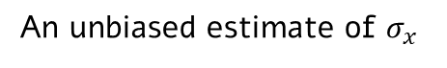
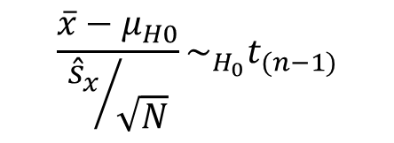
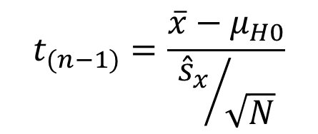
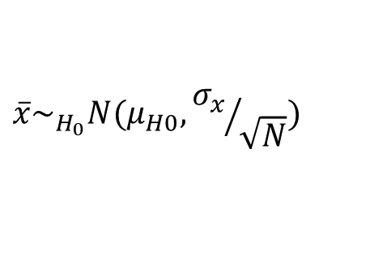
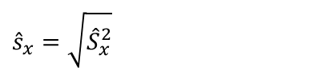
T-test: Unknown variance
$$\overline{x}\sim _{H_{0}}N(μ_{H0},{σ_{x}}/{\sqrt{N}})$$
$$Z=\frac{\overline{x}−μ_{H0}}{{σ_{x}}/{\sqrt{N}}}$$
We rarely use a z-test, because, practically speaking, we almost never know the population variance.
Mostly happens in stats classes ☺
Instead, we use a t-test: where we also estimate the population variance.
$$\frac{\overline{x}−μ_{H0}}{{σ_{x}}/{\sqrt{N}}}\sim _{H_{0}}N(0,1)$$
Why t distribution? (more math)
$$t_{(n−1)}=\frac{\overline{x}−μ_{H0}}{{{\hat{s}}_{x}}/{\sqrt{N}}}$$
$$\frac{\overline{x}−μ_{H0}}{{{\hat{s}}_{x}}/{\sqrt{N}}}\sim _{H_{0}}t_{(n−1)}$$
The statistic is no longer normally distributed; it follows a Student’s t-distribution.
The exact shape of the distribution is determined by another feature: Its degrees of freedom (df)
An unbiased estimate of $σ_{x}$
$${\hat{S}}_{x}^{2}=\frac{n}{n−1}⋅S_{x}^{2}=\frac{\sum{(x_{i}−\bar{x})^{2}}}{n−1}$$
Why unbiased?
$${\hat{s}}_{x}=\sqrt{{\hat{S}}_{x}^{2}}$$

Slide 35
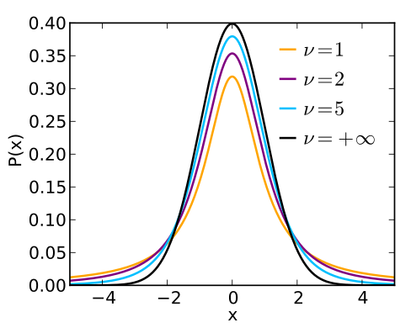
The t distribution
df=1
df=2
df=5
df=+∞
With df→∞, t=z
Intuitive definition of degrees of freedom (df): Number of observations needed (in addition to the mean) to compute the variance.
For one-sample t test: df = N-1
A t distribution is wider with less degrees of freedom (i.e., smaller N)
Intuitively plausible: the probability of observing the same result (same t-value) is associated with a smaller p-value when sample size is larger (more on that in next classes).

Slide 36

One-sample t-test: An example
Auditory Statistical Learning (ASL) task: (e.g., Saffran et al., 1996)
Familiarization phase:
bodesa
lemofa
ludegi
ridano
...
bodesaludegiridanobodesalemofaludegibodesa….
Test phase:
Which word belongs to the language?
Each Participant’s score:
number of correctly identified ‘words’ in a series of k 2-AFC trials
bodesa
vs.
bomogi
50% performance - change level, k/2 trials correct (=no SL abilty)
100% - perfect performance.

Slide 37
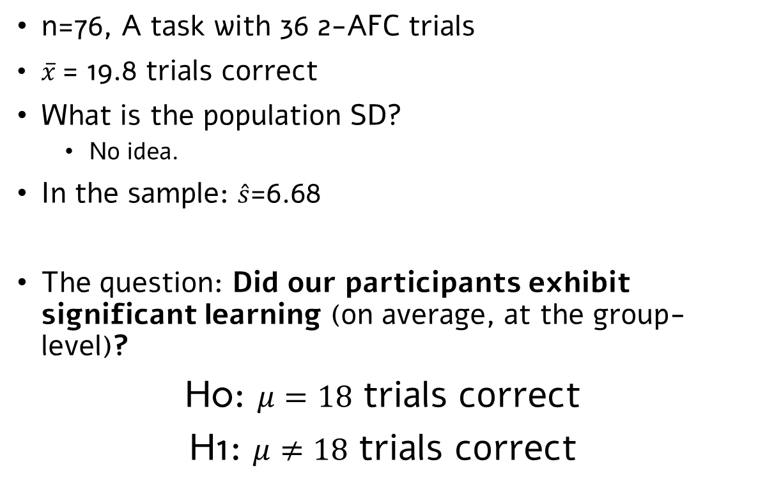
One-sample t-test: An example
Auditory Statistical Learning (ASL) task: (e.g., Saffran et al., 1996)
n=76, A task with 36 2-AFC trials
$\overline{x}$= 19.8 trials correct
What is the population SD?
No idea.
In the sample: $\hat{s}$=6.68
The question: Did our participants exhibit significant learning (on average, at the group-level)?
H0: $μ=18$ trials correct
H1: $μ≠18$ trials correct
Should we use here a directional or non-directional hypothesis?
Real numbers, from Siegelman & Frost, 2015

Slide 38

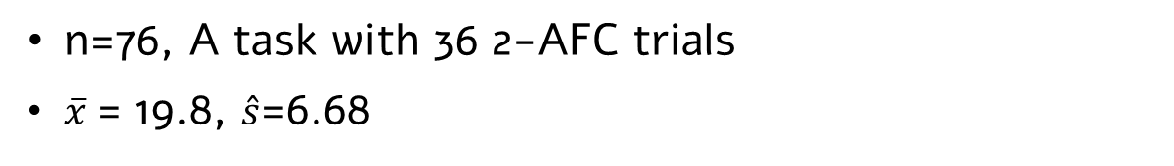
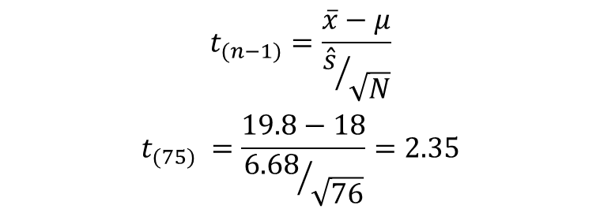
One-sample t-test: An example
Auditory Statistical Learning (ASL) task: (e.g., Saffran et al., 1996)
n=76, A task with 36 2-AFC trials
$\overline{x}$= 19.8, $\hat{s}$=6.68
$$t_{(n−1)}=\frac{\overline{x}−μ}{{\hat{s}}/{\sqrt{N}}}$$
$$t_{(75)} =\frac{19.8−18}{{6.68}/{\sqrt{76}}}=2.35$$
What would the p-value be under the ‘one-tailed’ option?
What is the p-value?
Check in R (e.g., pt() function)
Check online
Or just: Run the t-test in R and get all the info you need ☺ (in tutorial)

Slide 39
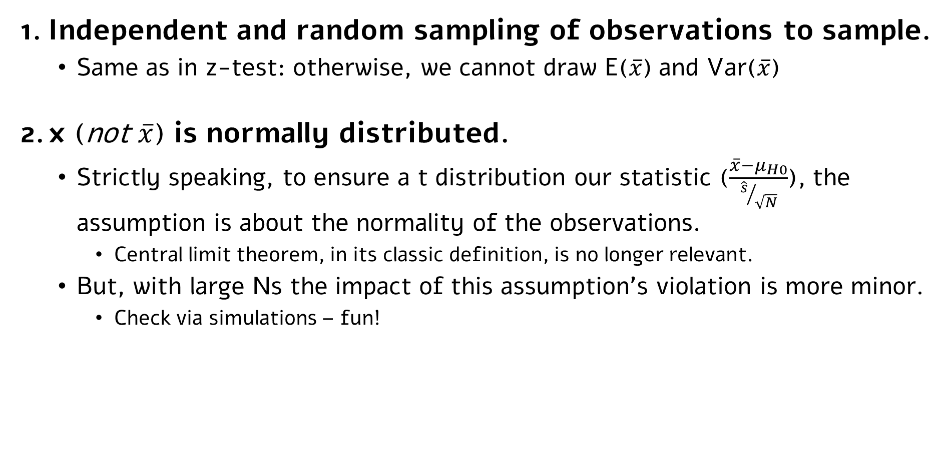
One sample t-test: assumptions
Independent and random sampling of observations to sample.
Same as in z-test: otherwise, we cannot draw E($\overline{x}$) and Var($\overline{x}$)
x (not $\overline{x}$) is normally distributed.
Strictly speaking, to ensure a t distribution our statistic ($\frac{\overline{x}−μ_{H0}}{{\hat{s}}/{\sqrt{N}}}$), the assumption is about the normality of the observations.
Central limit theorem, in its classic definition, is no longer relevant.
But, with large Ns the impact of this assumption’s violation is more minor.
Check via simulations – fun!

Slide 40
A very preliminary summary: General properties of NHST

Slide 41
General properties of NHST
All tests are based on assumptions.
Violation of assumptions lead to inflation of statistical errors (more on that throughout).
The tests lead to a dichotomous, and asymmetric, conclusion.
Dichotomous: Reject H0 / Don’t reject H0
Asymmetric: If reject H0 -> support for H1 (the complimentary hypothesis)
If not reject H0 -> no conclusion (cannot ‘accept’ H0).
All tests are probabilistic.
They include, by definition, a chance of (different types of) errors (next week).
Many tests have one-tailed and two-tailed variants, which assign alpha (Type I error) differently.
All tests so far (and vast majority of tests in general) are used to infer something about the population(s) mean(s).
Inter-subject variability is treated as error variance. Less variance → higher statistics (t/z values), lower (i.e., more significant) p-values.

Slide 42
Next week(s), on stats for graduate students
As we will go along in class, we will learn more and more tests allowing for more and more flexibility in data analysis.
Today – one population, numeric dependent variable.
… two populations (one independent variable with two levels)
… one independent variable with >2 levels
… multiple independent variables with >=2 levels
… continuous independent variable(s) (alone or when combined with categorical IV(s))
… non-numeric dependent variable
… complex dependence between observations.
All tests will have the same properties: Based on assumptions, lead to dichotomous and asymmetric conclusions, probabilistic in nature (and thus prone to errors), and generally, focus on central tendency.
How do these properties of NHST-based tests should shape how we use them in our pursuit of reproducible science?

Slide 43
A pop quiz! (kind of)

Slide 44
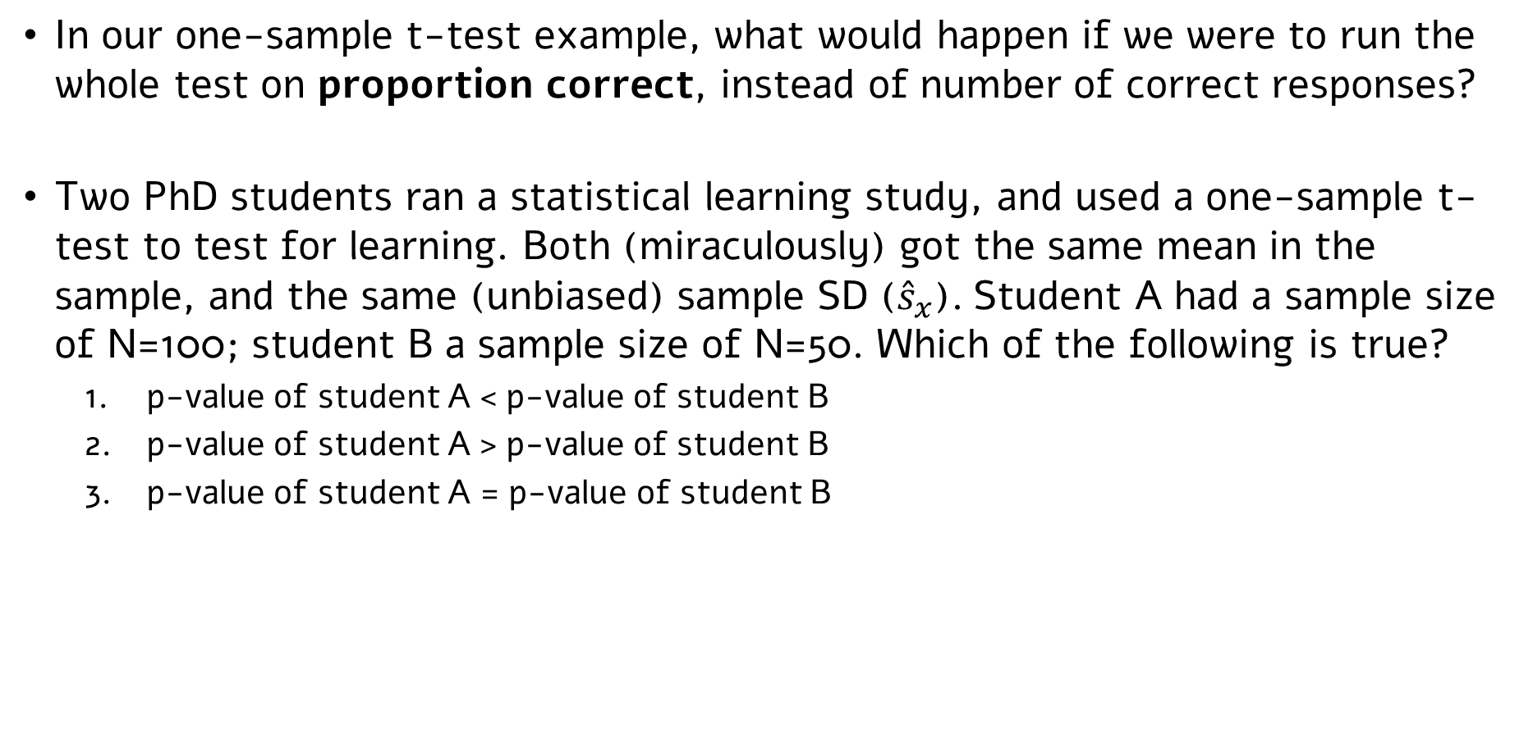
A pop quiz! (kind of)
In our one-sample t-test example, what would happen if we were to run the whole test on proportion correct, instead of number of correct responses?
Two PhD students ran a statistical learning study, and used a one-sample t-test to test for learning. Both (miraculously) got the same mean in the sample, and the same (unbiased) sample SD (${\hat{s}}_{x}$). Student A had a sample size of N=100; student B a sample size of N=50. Which of the following is true?
p-value of student A < p-value of student B
p-value of student A > p-value of student B
p-value of student A = p-value of student B

Slide 45
Extra slides: Some (but not a lot of) math

Slide 46

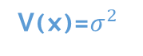
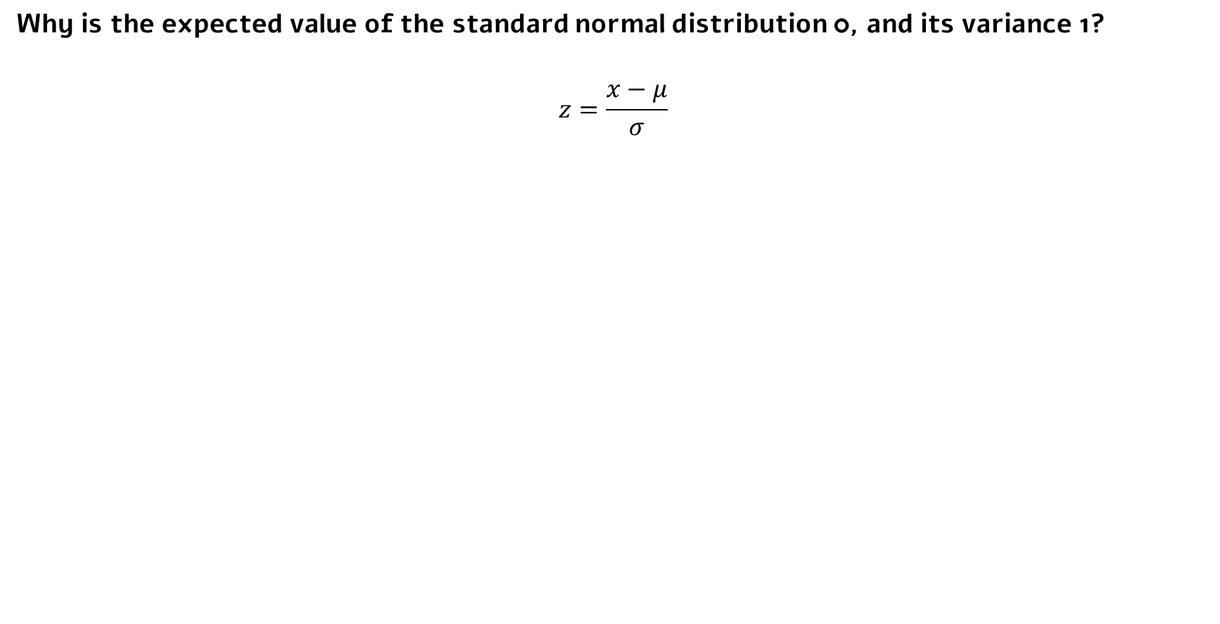

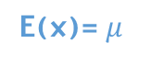

Standard normal distribution
Why is the expected value of the standard normal distribution 0, and its variance 1?
$$z=\frac{x−μ}{σ}$$
Expected value:
$$E\left(z\right)=E\left(\frac{x−μ}{σ}\right)=\frac{1}{σ}E\left(x\right)−\frac{μ}{σ}=\frac{1}{σ}E\left(x\right)−\frac{μ}{σ}=\frac{μ}{σ}−\frac{μ}{σ}=0$$
$μ$ and $σ$ are scalars
E(x)= $μ$
extract constants
$$V\left(z\right)=V\left(\frac{x−μ}{σ}\right)=\frac{1}{σ^{2}}V\left(x\right)=\frac{σ^{2}}{σ^{2}}=1$$
Variance:
V(x)=$σ^{2}$

Slide 47
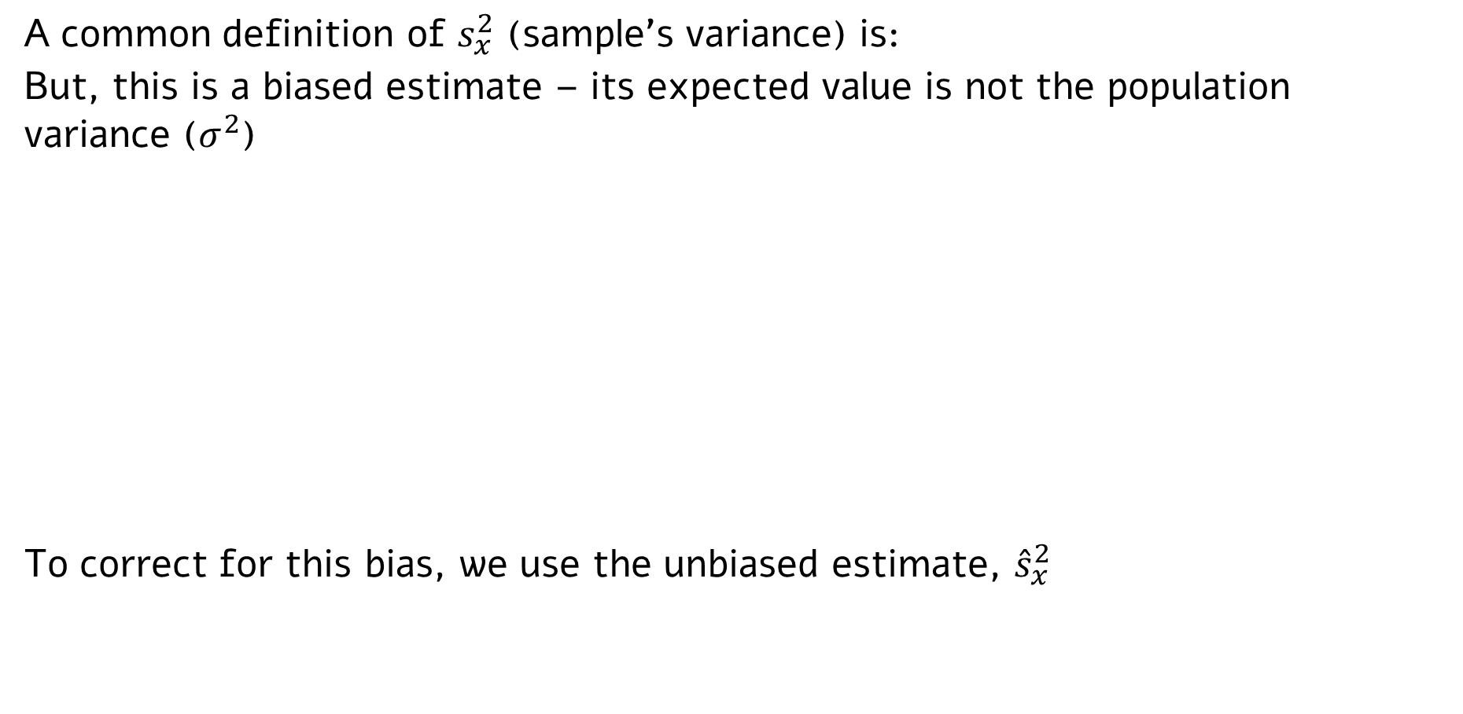
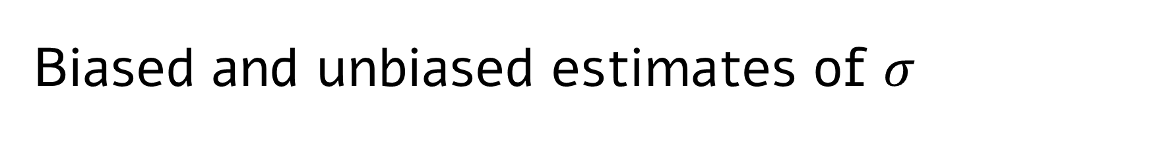
Biased and unbiased estimates of $σ$
A common definition of $s_{x}^{2}$ (sample’s variance) is:
But, this is a biased estimate – its expected value is not the population variance ($σ^{2}$)
To correct for this bias, we use the unbiased estimate, ${\hat{s}}_{x}^{2}$

Slide 48
A formal derivation of t distributions
See link below (in Hebrew); all rights reserved to Tal Nahari, Cognitive and Brain Sciences department.
https://www.dropbox.com/s/tin5f1lrc7oyoxu/%D7%A4%D7%99%D7%AA%D7%95%D7%97%20%D7%94%D7%A1%D7%98%D7%98%D7%99%D7%A1%D7%98%D7%99%20%D7%A9%D7%9E%D7%AA%D7%A4%D7%9C%D7%92%20t.pdf?dl=0

